Slide 1
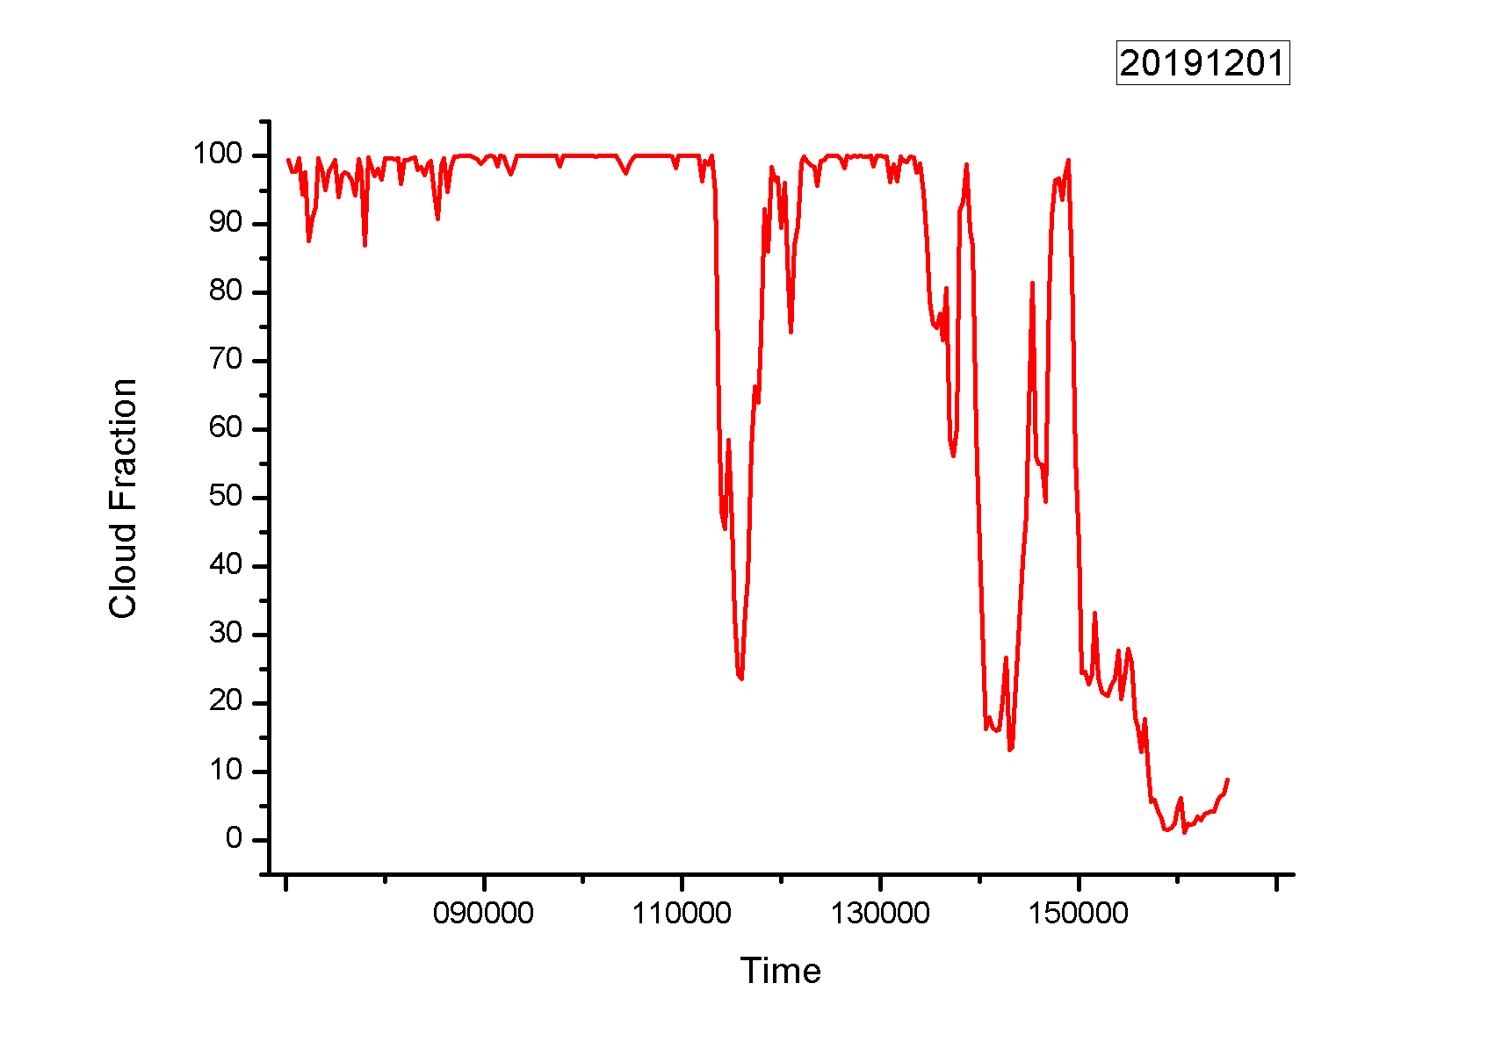
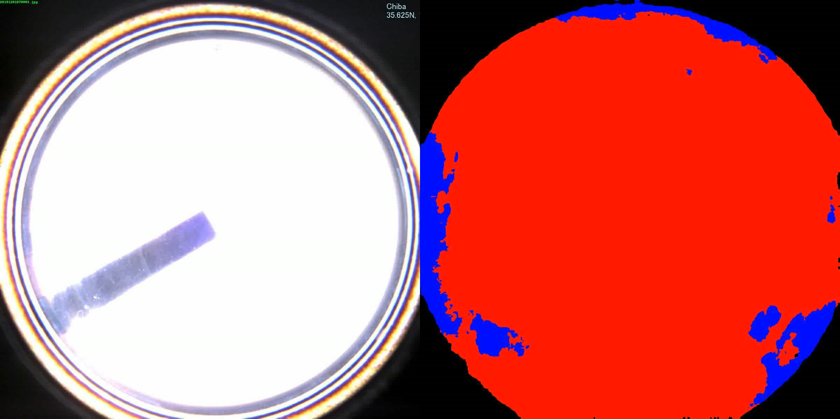
Cloud Fraction
2019.12.01
The video about skyview images and their segmentation
Cloud fraction

